Slide 1
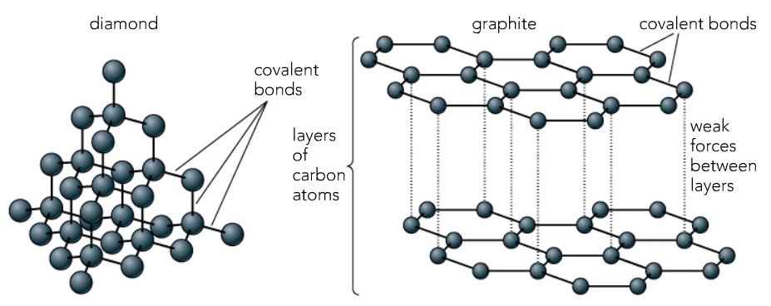
C2 Topic 3: Covalent Bonding and Separation
This topic looks at:
Covalent bonding
Separating techniques
Giant molecular covalent structures
Explain the differences in diamond and graphite, make reference to their structures.
What is covalent bonding and why does it occur?
Simple Covalent Bonding
Draw the covalent bonding in
Water H₂O
Chlorine Cl₂
Methane CH₄
Keywords: stable, full, shell, sharing, non metals,
What are the properties of simple covalent compounds and how do they compare to ionic compounds?
Keywords: strong, delocalised electrons, conduct, slide, layers

Slide 2
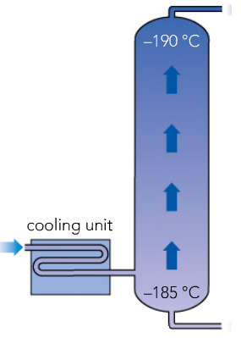
C2 Topic 3: Covalent Bonding and Separation
This topic looks at:
Covalent bonding
Separating techniques
Separating Air
How can you separate oxygen and nitrogen from air? Use the following diagram to help you
What do the following mean?
MISCIBLE
IMMISCIBLE
How could you separate
Miscible liquids
Immiscible liquids
Keywords: separating funnel, fractional distillation, boiling points,
What is chromatography and how can you calculate the r_{f} value
Keywords: freezing, oxygen, carbon dioxide, nitrogen, solvent, solution, solute

