Slide 1
Forces
Objects can affect other objects at a distance and changing the movement of an object requires a net force to be acting upon it.

Slide 2
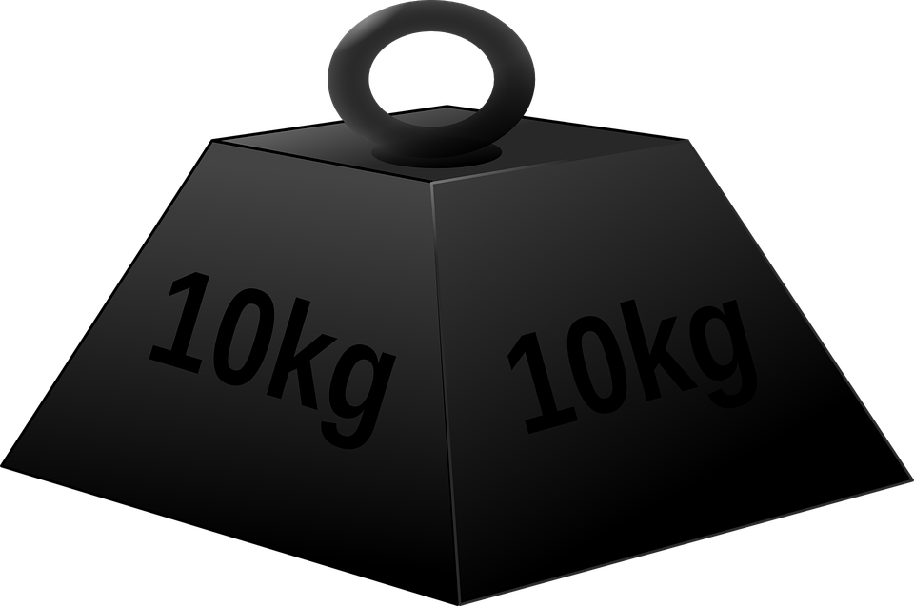

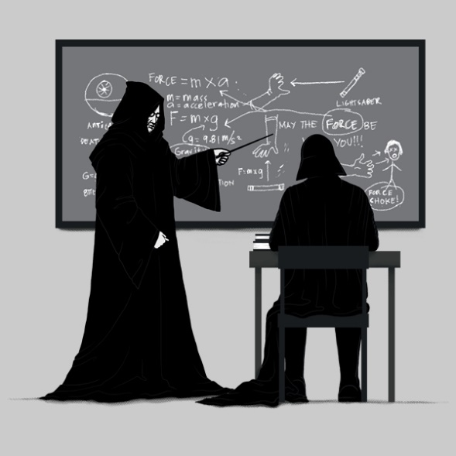
The Big Investigation
Investigate the effect of varying force (with constant mass) and then varying mass (with constant force) on an object on its acceleration.

Slide 3
Before we start our investigation
What skills do we need to develop?
What facts do we need to learn about?

Slide 4
How do we describe motion?
What is acceleration?
How do we measure motion and show our results?
How do force and mass effect acceleration?
Notes:
Activity 8. Preparation of a pure, dry sample of a soluble salt from an insoluble oxide or carbonate, using a Bunsen burner to heat dilute acid and a water bath or electric heater to evaporate the solution.

Slide 5

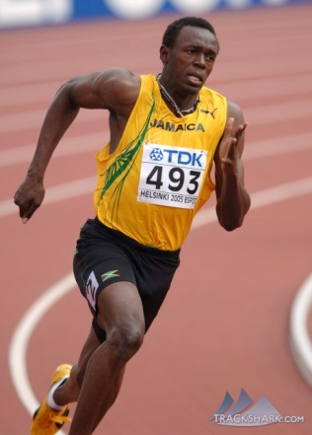
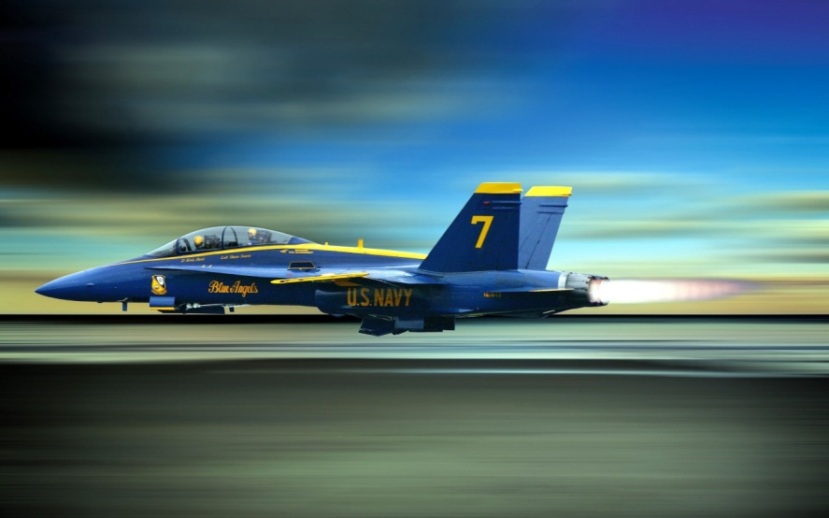
Scalars and Vectors
Write down the equations for
Speed
Distance
Time
Show the units of these quantities.
Task 1: in pairs write an explanation of the differences between scalar and vector quantities
Be prepared to tell the rest of the class
Today I will be able to describe distance, displacement, speed and velocity and calculate speed and velocity

Slide 6
Lesson Outcomes
Today I will be able to describe distance, displacement, speed and velocity and calculate speed and velocity
Success Criteria:
  Have a written description of distance and displacement
  Have a written description of speed and velocity
  Completed the calculations for speed and velocity
  Completed a distance/time graph worksheet.

Slide 7
Speed and Velocity
You can calculate speed:
  Is it a vector or a scalar quantity?
How is speed different to velocity?
Today I will be able to describe distance, displacement, speed and velocity and calculate speed and velocity

Slide 8
Speed questions
Do these calculations – Show your working out.
  Step 1: write down the equation you are using
  Step 2: rearrange if necessary – put in your numbers
  Step 3: solve – remember to check units.
A snail travels 15 mm in 60 seconds.
A plane travels 8000 miles in 4 ½ hours.
A sprinter runs 200 m in 23.2 seconds.
Today I will be able to describe distance, displacement, speed and velocity and calculate speed and velocity

Slide 9
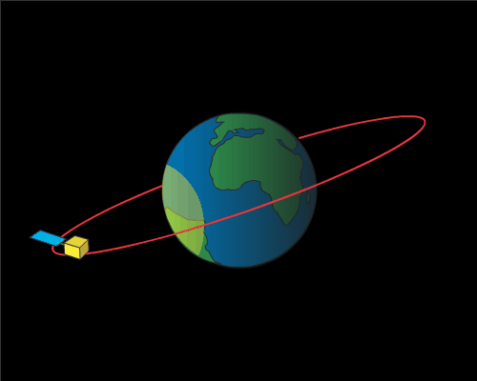
Distance and displacement
Watch the animation and then the volunteer.
Two minutes to have a think and a quiet discussion with your partner. Relate distance and displacement to the action and animation you have seen.
Be prepared to feedback your ideas
Today I will be able to describe distance, displacement, speed and velocity and calculate speed and velocity

Slide 10
Definitions
Distance: The number of metres (or miles/km etc.) travelled by an object during a journey.
Displacement: The straight line distance and direction from an objects starting position to its finishing position.
Today I will be able to describe distance, displacement, speed and velocity and calculate speed and velocity

Slide 11
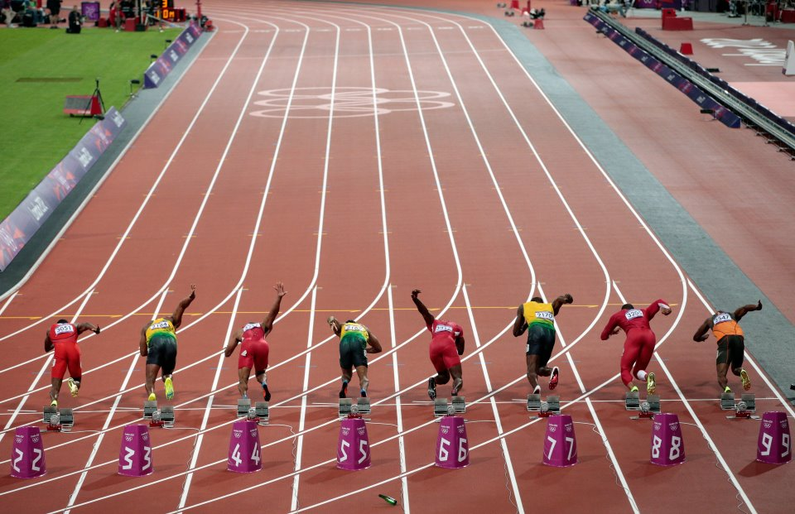
How can we show this?
Lets think about a 100m race
What could we use to show both quantities?
Today I will be able to describe distance, displacement, speed and velocity and calculate speed and velocity

Slide 12
Distance/time graph
Today I will be able to describe distance, displacement, speed and velocity and calculate speed and velocity

Slide 13

Displacement/time graph
Today I will be able to describe distance, displacement, speed and velocity and calculate speed and velocity

Slide 14
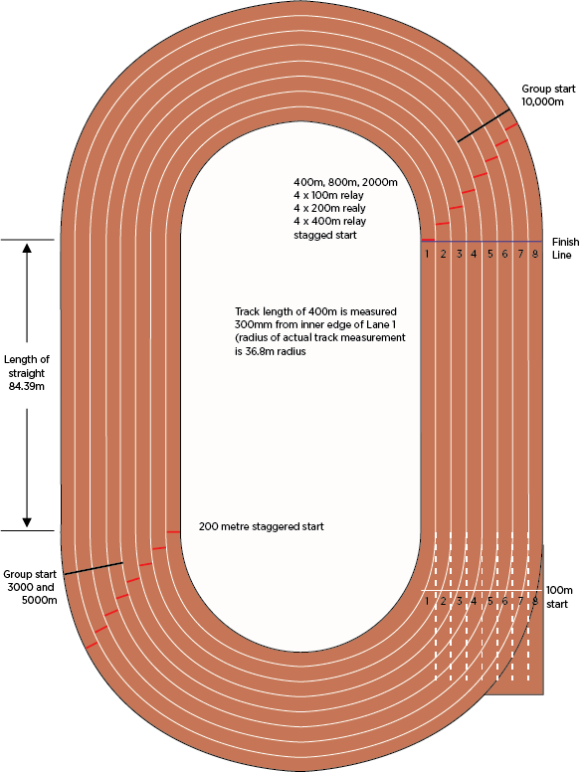
How can we show this?
Lets think about a 400m race
What could we use to show both quantities?
Today I will be able to describe distance, displacement, speed and velocity and calculate speed and velocity

Slide 15
Distance/time graph
Today I will be able to describe distance, displacement, speed and velocity and calculate speed and velocity

Slide 16
Displacement/time graph
Today I will be able to describe distance, displacement, speed and velocity and calculate speed and velocity

Slide 17
Distance/time graph
Distance (m)
Stationary – not moving!!!
Time (s)
Today I will be able to describe distance, displacement, speed and velocity and calculate speed and velocity

Slide 18
Distance/time graph
How fast?
S = D = 10m = 2 m/s
Distance (m)
T 5 s
Constant speed
10
Time (s)
5
Today I will be able to describe distance, displacement, speed and velocity and calculate speed and velocity

Slide 19
Distance/time graph
Distance (m)
Speeding up – accelerating!!
Can you explain why?
Time (s)
Today I will be able to describe distance, displacement, speed and velocity and calculate speed and velocity

Slide 20
Distance/time graph
Distance (m)
slowing down – decelerating!!
Can you explain why?
Time (s)
Today I will be able to describe distance, displacement, speed and velocity and calculate speed and velocity

Slide 21
100m race
Complete the 100m race worksheet – 15 mins
We will self assess and discuss answers.
Today I will be able to describe distance, displacement, speed and velocity and calculate speed and velocity

Slide 22
Homework!
Complete the ‘How fast can you run?’ worksheet.
To be handed in ……
Today I will be able to describe distance, displacement, speed and velocity and calculate speed and velocity

