Slide 1
Forces
Objects can affect other objects at a distance and changing the movement of an object requires a net force to be acting upon it.

Slide 2
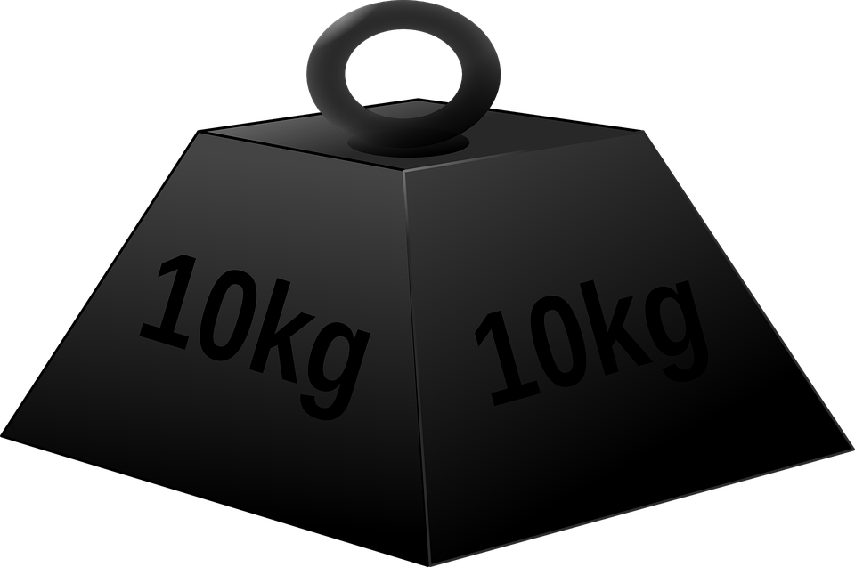

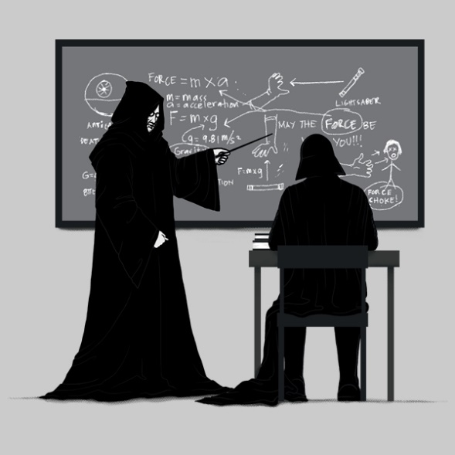
The Big Investigation
Investigate the effect of varying force (with constant mass) and then varying mass (with constant force) on an object on its acceleration.

Slide 3


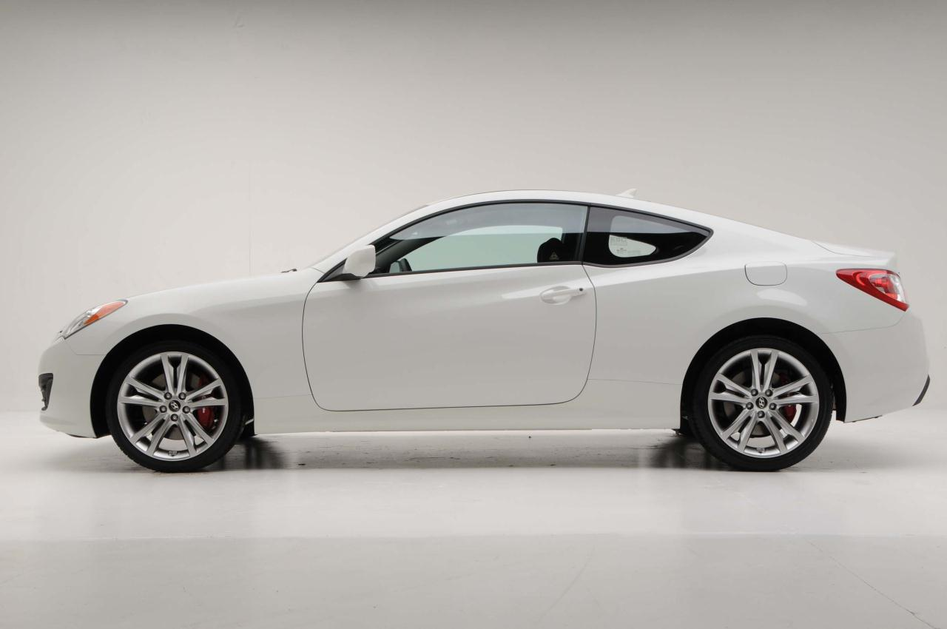
Stopping a moving car
Draw a free body diagram of a car stopping. Label all the forces (remember magnitude is the length of the force arrow) acting on it and the resultant (if any) force.
Today I will be able to describe the motion of an object from a velocity/time graph.
I will be able to calculate acceleration and distance using a velocity/time graph

Slide 4

Lesson Outcomes
Today I will be able to define stopping distance, thinking distance and braking distance and discuss factors affecting these
Success Criteria:
Define Stopping distance as thinking plus braking distance
Analyse factors that will affect these
Apply knowledge to solve problems relating to stopping distances.

Slide 5

Stopping distance
What does this mean?
THINK
PAIR
SHARE
2 minutes!
Today I will be able to define stopping distance, thinking distance and braking distance and discuss factors affecting these

Slide 6
Stopping distances
How long does it take a moving vehicle to stop?


Thinking distance is the distance a car travels before the brakes are applied.
Braking distance is the distance a car travels whilst the brakes are being applied.
Braking distance
Thinking distance
The stopping distance is the sum of the thinking distance and the braking distance.
Stopping distance
Stopping distance = thinking distance + braking distance

Slide 7
Braking distance
Thinking distance
The distance the car travels in the split second between a hazard appearing and the driver applying the brakes
The distance the car travels during its deceleration, whilst the brakes are being applied

Slide 8
The total stopping distance = thinking distance + braking distance
30mph
9m +
14m = 6 car lengths
50mph
15m + 38m = 13 car lengths
70mph
21m + 75m = 24 car lengths

Slide 9
Thinking distance
What is going to affect the thinking distance of a driver?
Think
Pair
Share
2 mins
Today I will be able to define stopping distance, thinking distance and braking distance and discuss factors affecting these

Slide 10
Thinking distance
How fast you are going – the faster you are going the more distance you will go while you are reacting to a hazard
Your reaction time – how fast you respond to hazards.
  This can be affected by;
  Tiredness
  Alcohol or drugs
  Lack of concentration – phones/texting/changing music
  A typical reaction time is between 0.2 and 0.9 seconds.
Today I will be able to define stopping distance, thinking distance and braking distance and discuss factors affecting these

Slide 11
Braking distance
What is going to affect the braking distance of a car?
Think
Pair
Share
2 mins
Today I will be able to define stopping distance, thinking distance and braking distance and discuss factors affecting these

Slide 12
Braking distance
How fast you are going – the faster you go the more distance it takes to stop
How good your brakes are – worn or faulty brakes will not apply as much force as good, well maintained brakes and could fail in an emergency
How good the tyres are – tyres need a minimum tread depth of 1.6mm. This helps in wet conditions to disperse surface water away from the contact are between tyre and road.
Weather conditions – hot dry days will increase the friction between tyre and road, wet or icy conditions will decrease the friction leading to longer braking distances
Today I will be able to define stopping distance, thinking distance and braking distance and discuss factors affecting these

Slide 13
Speed and stopping distance
If a cars speed doubles, thinking distance will double.
If a cars speed doubles, braking distance increases four fold (2²).
If a cars speed trebles, braking distance increases nine fold (3²)
So we can say braking distance increases with the square of the scale factor of the speed increase.
Today I will be able to define stopping distance, thinking distance and braking distance and discuss factors affecting these

Slide 14
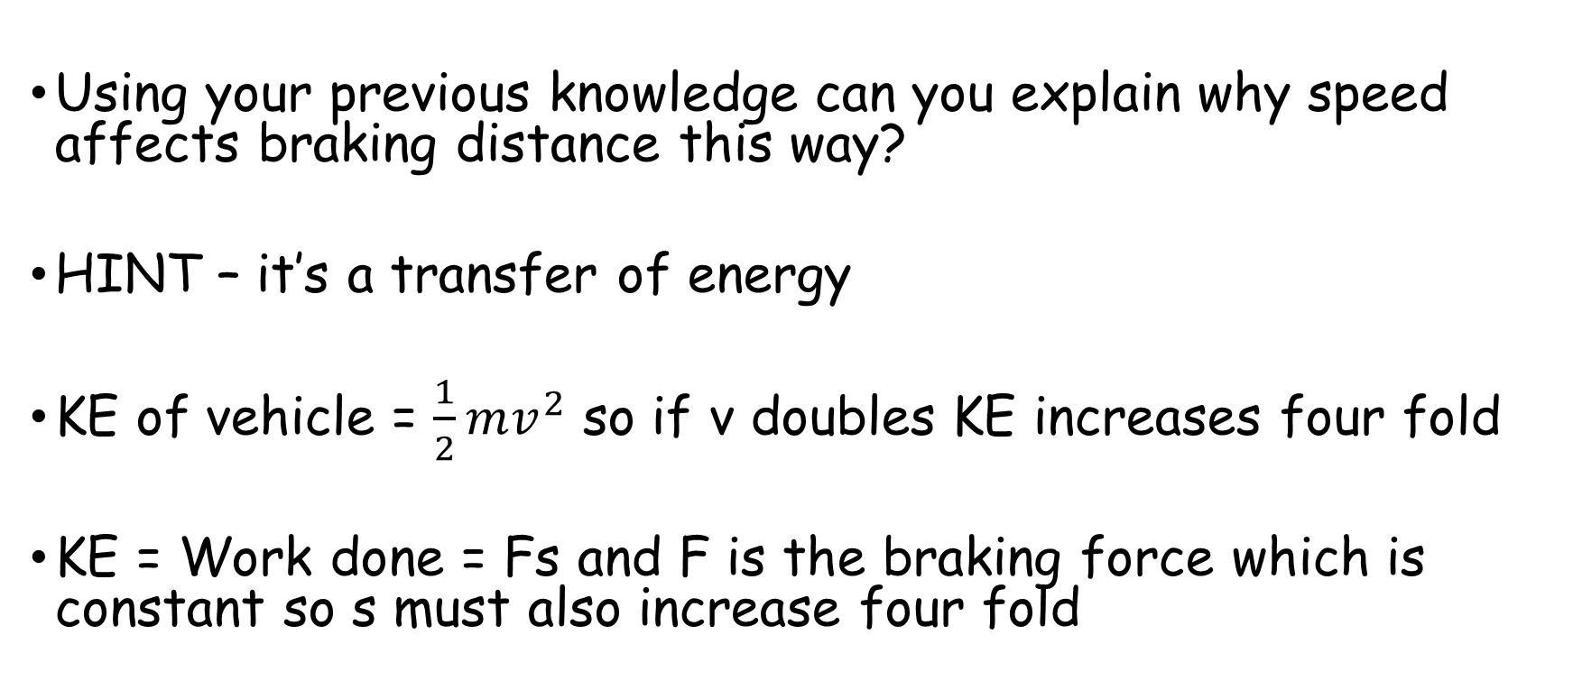
Speed and braking distance
Using your previous knowledge can you explain why speed affects braking distance this way?
HINT – it’s a transfer of energy
KE of vehicle = $\frac{1}{2}mv^{2}$ so if v doubles KE increases four fold
KE = Work done = Fs and F is the braking force which is constant so s must also increase four fold
Today I will be able to define stopping distance, thinking distance and braking distance and discuss factors affecting these

Slide 15

Worked example
Today I will be able to define stopping distance, thinking distance and braking distance and discuss factors affecting these

Slide 16
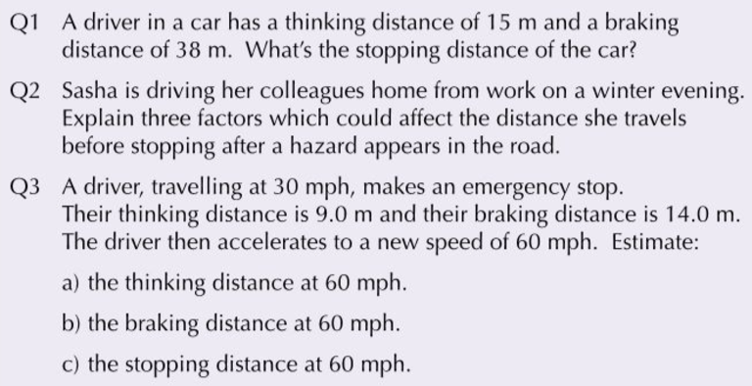
Your turn
Today I will be able to define stopping distance, thinking distance and braking distance and discuss factors affecting these

Slide 17
Your turn
Today I will be able to define stopping distance, thinking distance and braking distance and discuss factors affecting these

