Slide 1
Organisms are organised on a cellular basis and require a supply of energy or materials.

Slide 2
Before we start our investigation
What skills do we need to develop?
What facts do we need to learn about?

Slide 3
Think, pair, share
HEALTH –what does this mean?

Slide 4
Learning outcomes
To define the terms ‘health’ and ‘disease’
To be able to classify diseases
To describe risk factors for non-communicable diseases

Slide 5
Health
Health is a state of physical and mental well being
Diseases are causes of ill-health

Slide 6
Make a list of as many diseases as you can think of
Put the diseases into groups – you decide how to group them – you must be prepared to JUSTIFY your decisions

Slide 7
Communicable diseases
These are diseases that can be CAUGHT. They are transmitted by microorganisms. These can be:
Virus
Bacteria
Fungi
Protist

Slide 8
Non-communicable diseases
Obesity
Diabetes
Cancer (though some viruses can trigger cancers)
Allergies
Coronary heart disease
What do all these diseases have in common?

Slide 9
Disease Classification
Communicable disease can be ‘caught’ or transmitted form one organism to another.
Re-group your list into communicable diseases and non-communicable diseases

Slide 10
Expert Challenge
Use the ipads for research
See task sheet for instructions and success criteria
Diseases to allocate:
HIV TOBACCO MOSAIC VIRUS MEASLES
GONORRHOEA MALARIA SALMONELLA
ROSE BLACK SPOT

Slide 11
Lifestyle factors
Lifestyle factors can have a profound impact on causing ill health
For example a high fat diet can cause obesity and CHD
What other lifestyle factors affect ill-health?

Slide 12
Smoking – leads to increased risk of CHD and cancers
Alcohol- leads to liver disease, loss of brain function and can affect unborn children
Obesity can increase the risk of type 2 diabetes
Lack of regular exercise – increased risk of type 2 diabetes, obesity and CHD
Carcinogens - cancers

Slide 13
Disease Data
Draw conclusions from data
What questions do you still have about each graph?
How reliable is the data?

Slide 14
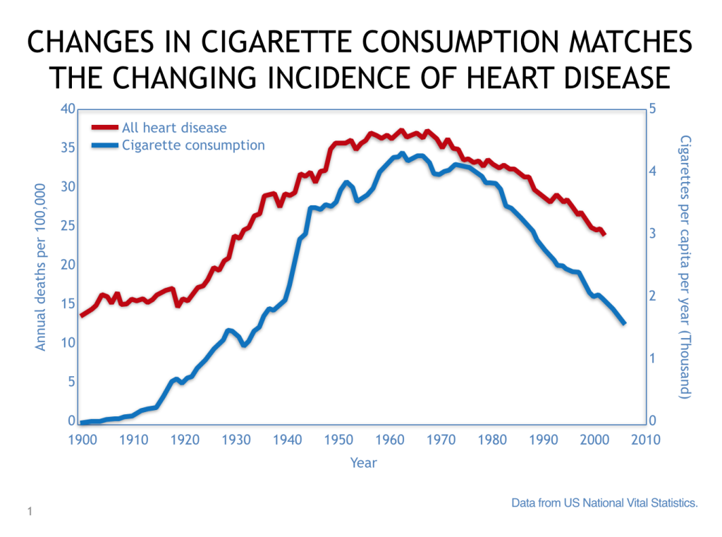
Disease Data

Slide 15
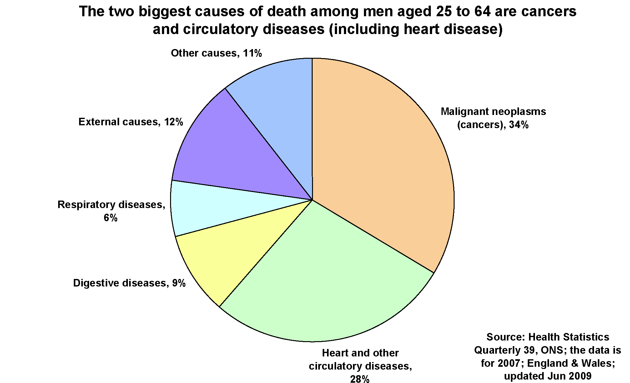

Slide 16
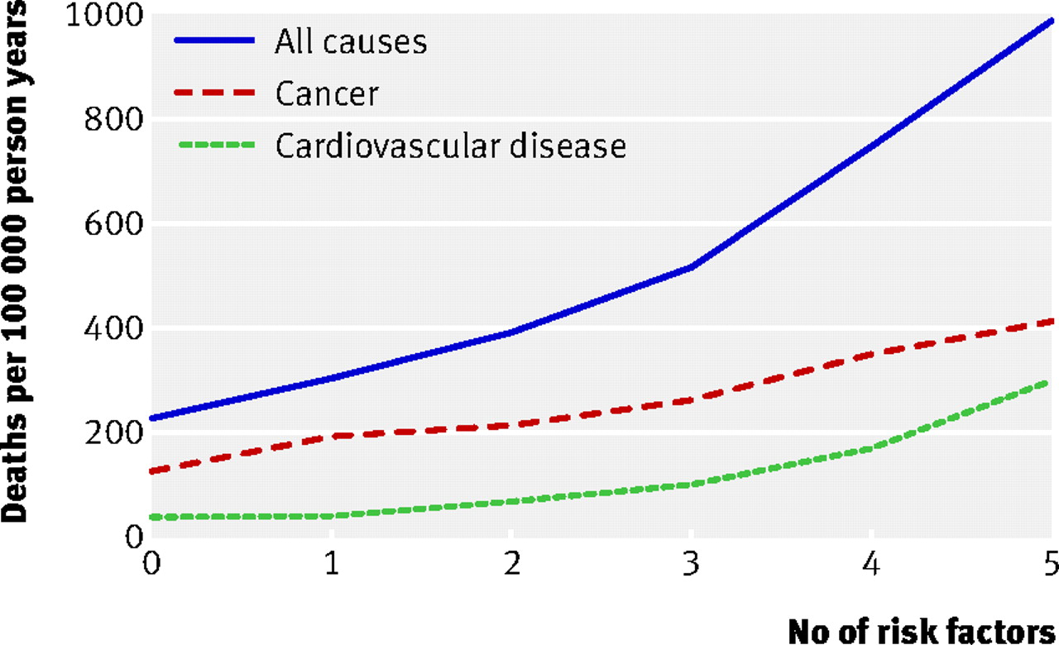

Slide 17
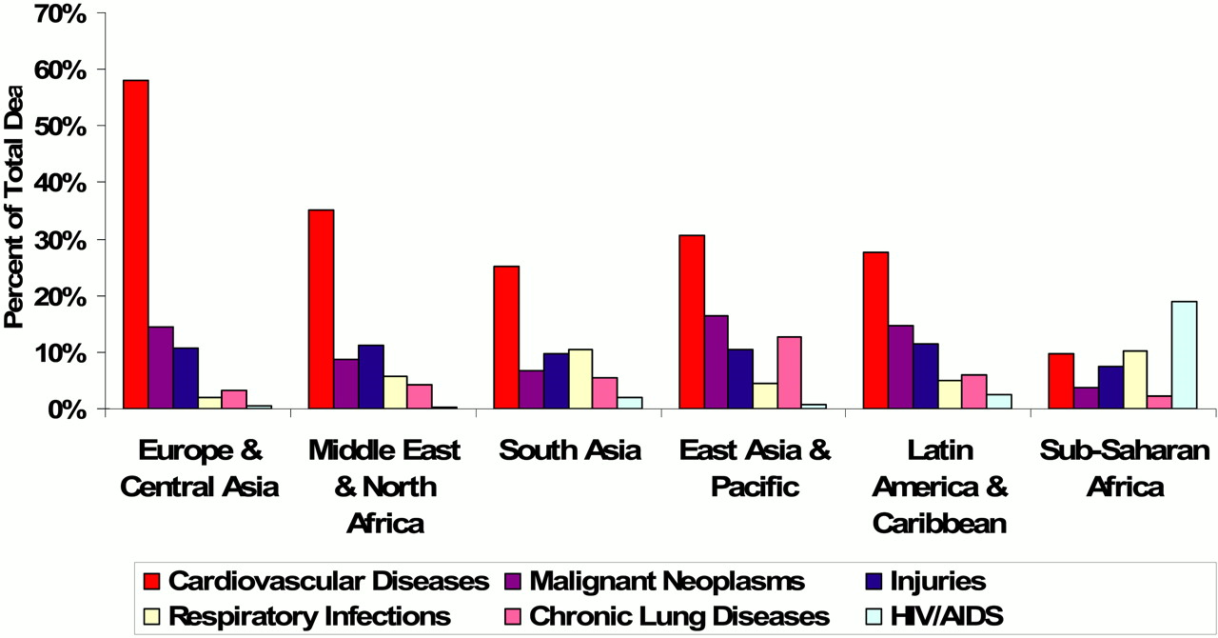

Slide 18
HOMEWORK
For homework you must produce a leaflet for a doctor’s surgery advising people on how to live a better lifestyle. You should describe risk factors and the effects of these.
You need to include data to support your claims.

Slide 19
Communicable diseases

Slide 20
Expert challenge:
Communicable Diseases
Notes:
Demo

Slide 21
Learning outcomes
To be able to define the term ‘communicable diseases’
To be able to describe the causes and effects of a range of communicable diseases

Slide 22
Communicable diseases
These are diseases that can be CAUGHT. They are transmitted by microorganisms. These can be:
Virus
Bacteria
Fungi
Protist

Slide 23
Expert Challenge
Use the ipads for research
See task sheet for instructions and success criteria
Diseases to allocate:
HIV TOBACCO MOSAIC VIRUS MEASLES
GONORRHOEA MALARIA SALMONELLA
ROSE BLACK SPOT

Slide 24
Cancer
Cancer is disease that is caused by cell division occurring incorrectly.
What are the two types of cell division?

Slide 25
Learning outcomes
Describe what is meant by ‘cancer’
Compare tumour types

Slide 26
Cancer
Occurs when cell division is uncontrolled
Tumours are developed
Two types of tumours
Benign – non-cancerous but can cause complications
Malignant – cancerous and these calls can travel to other parts of the body and invade other tissues. This is known as METASTATIC cancer

Slide 27
Causes and risk factors
What do the following terms mean
Risk factor
Cause
Prevalence
Epidemic

Slide 28
Causes and risk factors
Make a list of as many known causes and risk factors for cancers

Slide 29
Immunity
On the outline of the man label as many parts of the body that prevent against infection
For each, state whether they are chemical or physical

Slide 30
Primary defences
Chemical:
Stomach acid
Earwax
Tears
Urine flow
Mucus
Physical
Skin
Hairs (cilia)
Platelets

Slide 31
Dealing with disease
Describe primary lines of defence
Explain how the immune system works

Slide 32
We CATCH diseases all the time.
WHY don’t we SUFFER from them very often?

Slide 33
How do we get ill?
Bacteria: When bacteria get into our body they RAPIDLY REPRODUCE and SECRETE TOXINS which damage cells making us feel ill quickly
Viruses: When viruses invade our body they enter cells and reproduce inside of them – eventually damaging the cells making us ill. As viruses are inside of cells antibiotics are ineffective at treating them.

Slide 34
Immune System
Your body has two lines of defence:
Primary – chemical and physical barriers
Secondary – the immune system
The immune system consists of WHITE BLOOD CELLS and the chemicals that they produce.

Slide 35
The immune system
White blood cells
Produce antibodies – see next slide and video
Produce antitoxins- neutralise the toxins secreted by bacteria
Engulf and digest microorganisms (phagocytosis)- this directly destroys and gets rid of the pathogens.
Watch the video:
https://www.youtube.com/watch?v=Jp45a42gxYQ

Slide 36


Slide 37
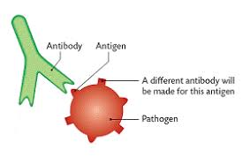
Antibodies and antigen
Both are proteins. Antigens are found on the PATHOGEN (GEN +GEN)
Antibodies are produced by the body (WBCs)
(BODY + BODY)
They have a specific SHAPE.

Slide 38
Complete the activity-immune system sequencing exercise

Slide 39
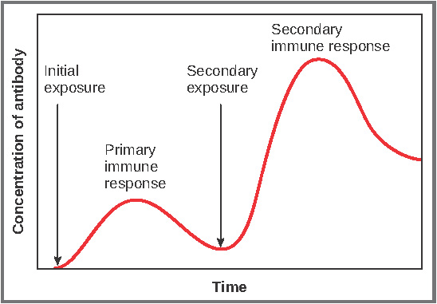
Describe and explain this graph

Slide 40
Complete the activity:
Brian’s night out…

Slide 41
Monoclonal Antibodies (TRIPLE only)
There are three types of white blood cell (lymphocyte) which each have a different function (previous lesson)
  Produce antibodies
  Engulf pathogens/bacteria
  Produce antitoxins
White blood cells can divide happily, however… once a WBC produces antibodies it can no longer divide!

Slide 42
Monoclonal antibodies (triple only)
As antibodies are very specific scientists use them to identify particular substances…
But to do this they need identical antibodies in large quantities
Remember though… white blood cells which produce antibodies cannot divide (B lymphocyte)
So how do we get so many identical antibodies????

Slide 43
To get round this problem in a laboratory a B lymphocyte from a mouse is fused with a cancer cell that can divide hundreds of times.
This creates a hybridoma.
Hybridoma = cells that multiply indefinitely in the laboratory and can be used to produce a specific antibody indefinitely

Slide 44
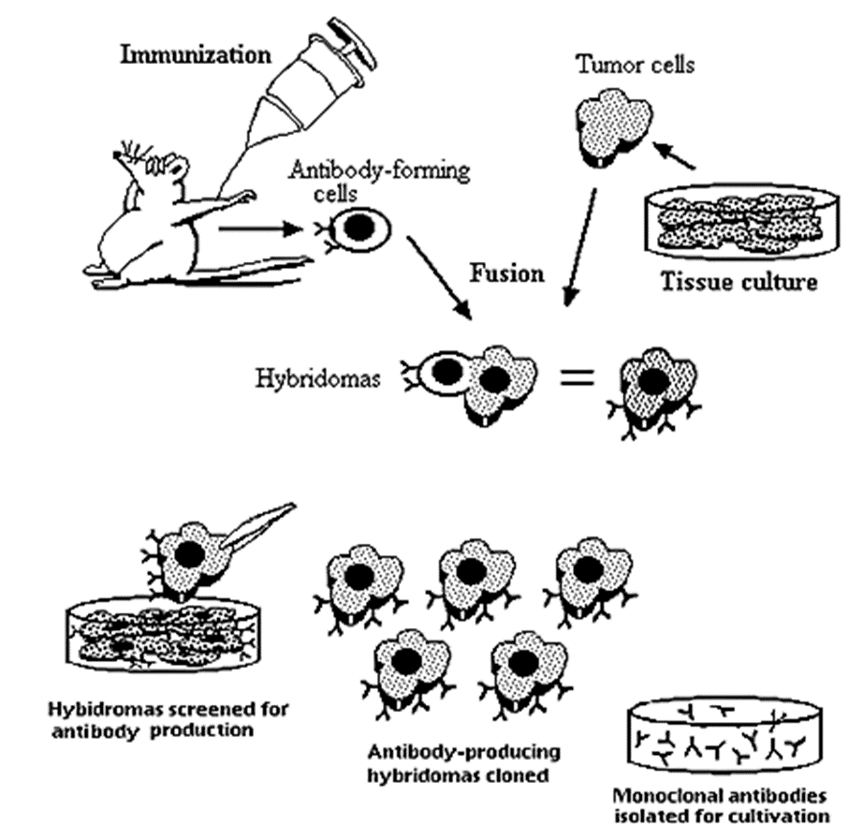

Slide 45
Uses of monoclonal antibodies
for diagnosis such as in pregnancy tests
• in laboratories to measure the levels of hormones and other chemicals in blood, or to detect pathogens
• in research to locate or identify specific molecules in a cell or tissue by binding to them with a fluorescent dye
• to treat some diseases: for cancer the monoclonal antibody can be bound to a radioactive substance, a toxic drug or a chemical which stops cells growing and dividing. It delivers the substance to the cancer cells without harming other cells in the body.

Slide 46
Monoclonal antibodies
Complete the sheet

